Slide 1
Converting an Image to Sound and Hit in Another Image.
Carlos guzman

Slide 2
Introduction
Inspiration for Image-to-Sound Map
Older cameras used a photodiode to capture energy from a light source.
Need X & Y displacement to produce image.
Combination with rotating drum to produce entire image area.
Improvement for scanners and digital cameras by using a line sensor or a 2-D array sensor.
Steganography
The practice of concealing secret information in a multimedia object such as an image or a video.
The secret signal must be unnoticeable in the cover image.
2 domains to hide information
Spatial: the pixel (2D) or amplitude (1D) values are used
Frequency: Wavelet Coefficients (1D: cA & cD) (2D: LL, LH, HL, HH)

Slide 3
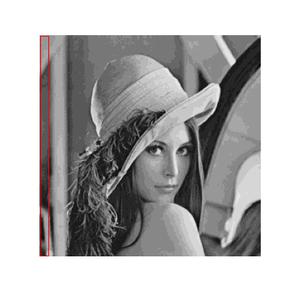
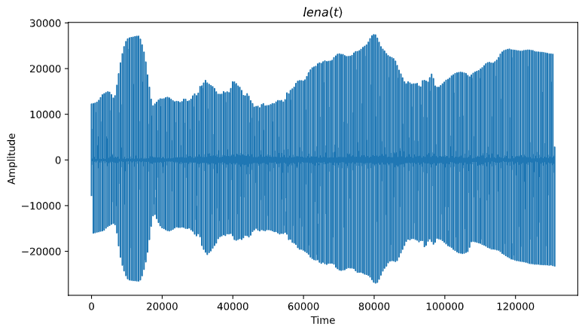


Image-to-sound
Assume the image is in the frequency domain. To covert the image to sound and back, we use a DFT inspired method.
$s\left(t\right)=s_{l}\left(n\right)=\sum_{k=0}^{K−1}{p_{kl}\sin\left(ω_{k}n+φ_{k}\right)}$,
$$where, 0≤n<N$$
Take the Inverse Fourier Transform of the image column by column (frame). Combine the frames into one 1-D array.
S[0..T-1], where t < T (time), and S[t] is the amplitude value.
WARNING LOWER YOUR VOLUME

Slide 4

SOUND-TO-IMAGE
Now that we are in the spatial domain, to map the image to sound, we take the DFT of the sound signal.
Take each frame and map it back to a column, each value in the frame corresponds to part of the original pixel value.
$y\left(t\right)=y_{l}\left(n\right), where t=lK+n$,
$q_{kl}=\left|\sum_{n=0}^{N−1}{y_{l}\left(n\right)e^{−jω_{k}n}}\right|,$
$where, N=2K and k=[0,…,K−1]$

Slide 5
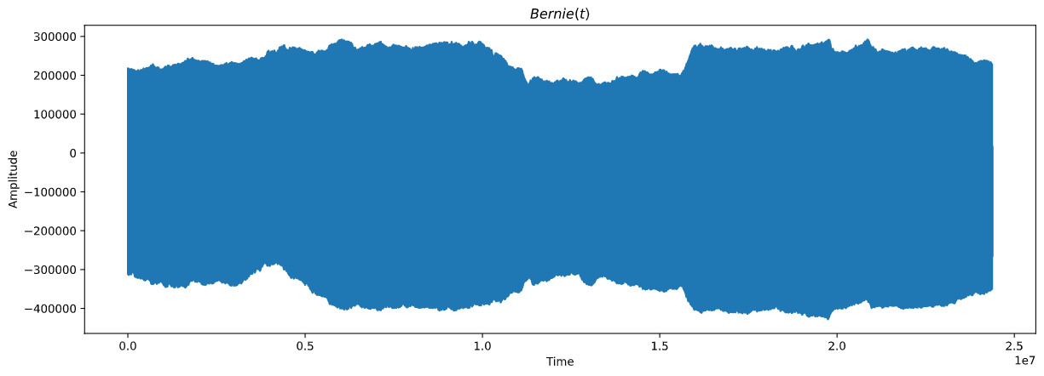
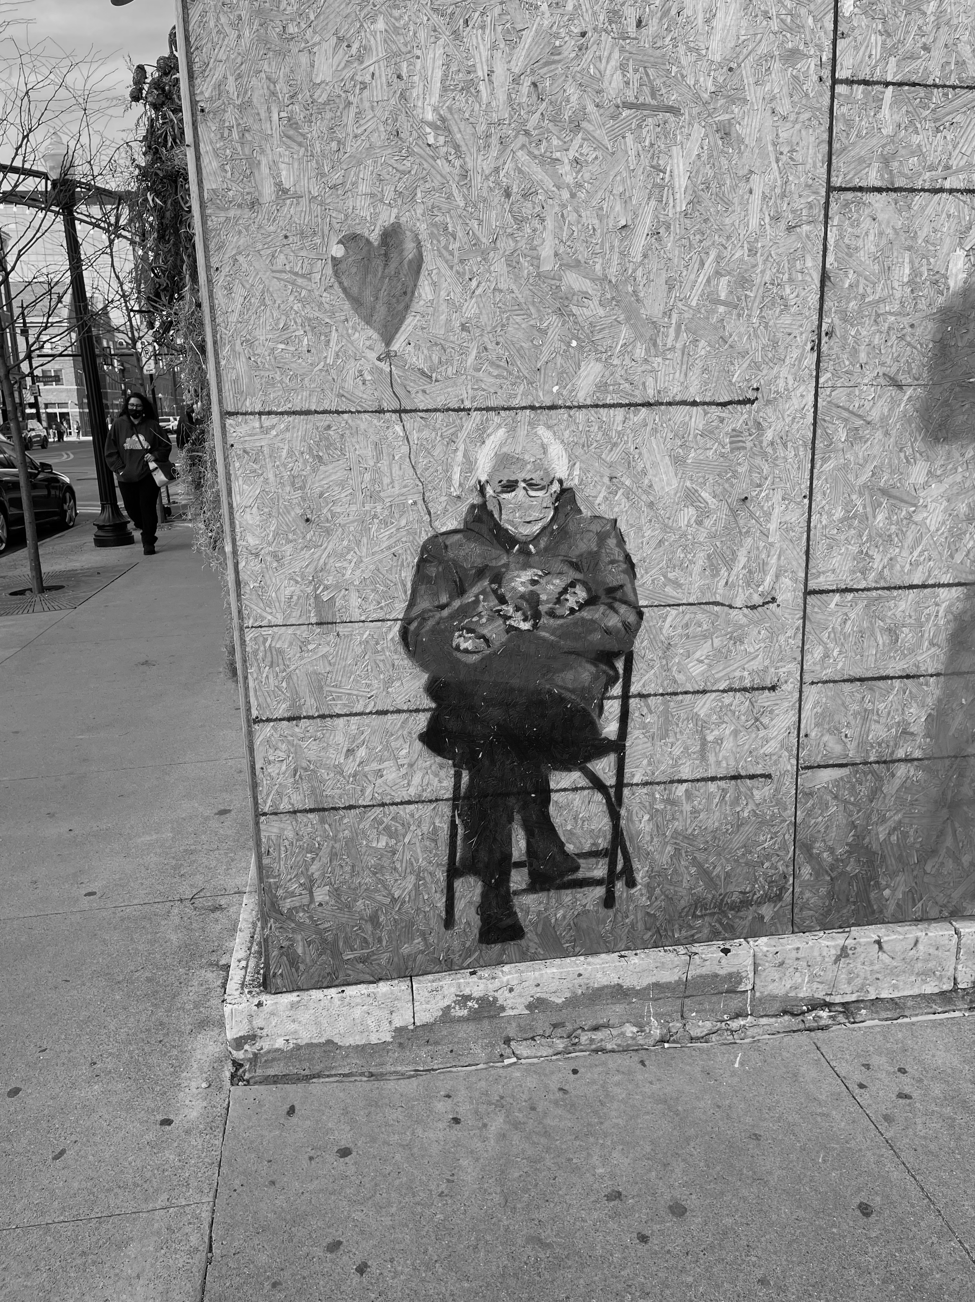
DFT
iDFT

Slide 6
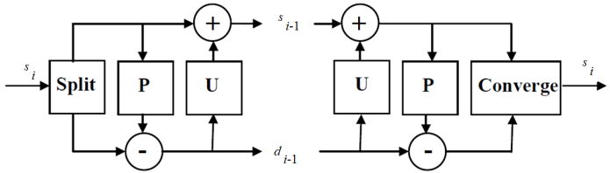

Integer-to-integer haar wavelet transform
Same as the Haar Wavelet Transform we learned in class. We will have integers at each level.
Uses the integers in the even indexed samples to predict the odd indexed samples.
DWT: $d_{i−1}=S_{n}\left(Odds\right)−S_{n}\left(Evens\right),$ $S_{i−1}=S_{n}\left(Evens\right)+ \left\lfloor \frac{d_{i−1}}{2}\right\rfloor$
Inverse: $S_{n}\left(Evens\right)=S_{n−1}+\left\lfloor \frac{d_{i−1}+1}{2}\right\rfloor , S_{n}\left(Odds\right)=S_{n−1}−\left\lfloor \frac{d_{i−1}}{2}\right\rfloor$
Evens
Odds

Slide 7
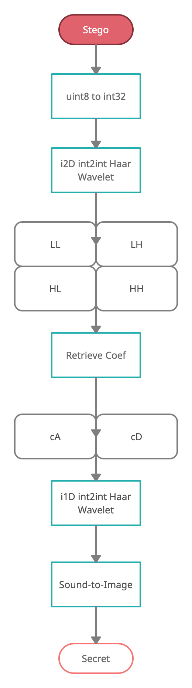
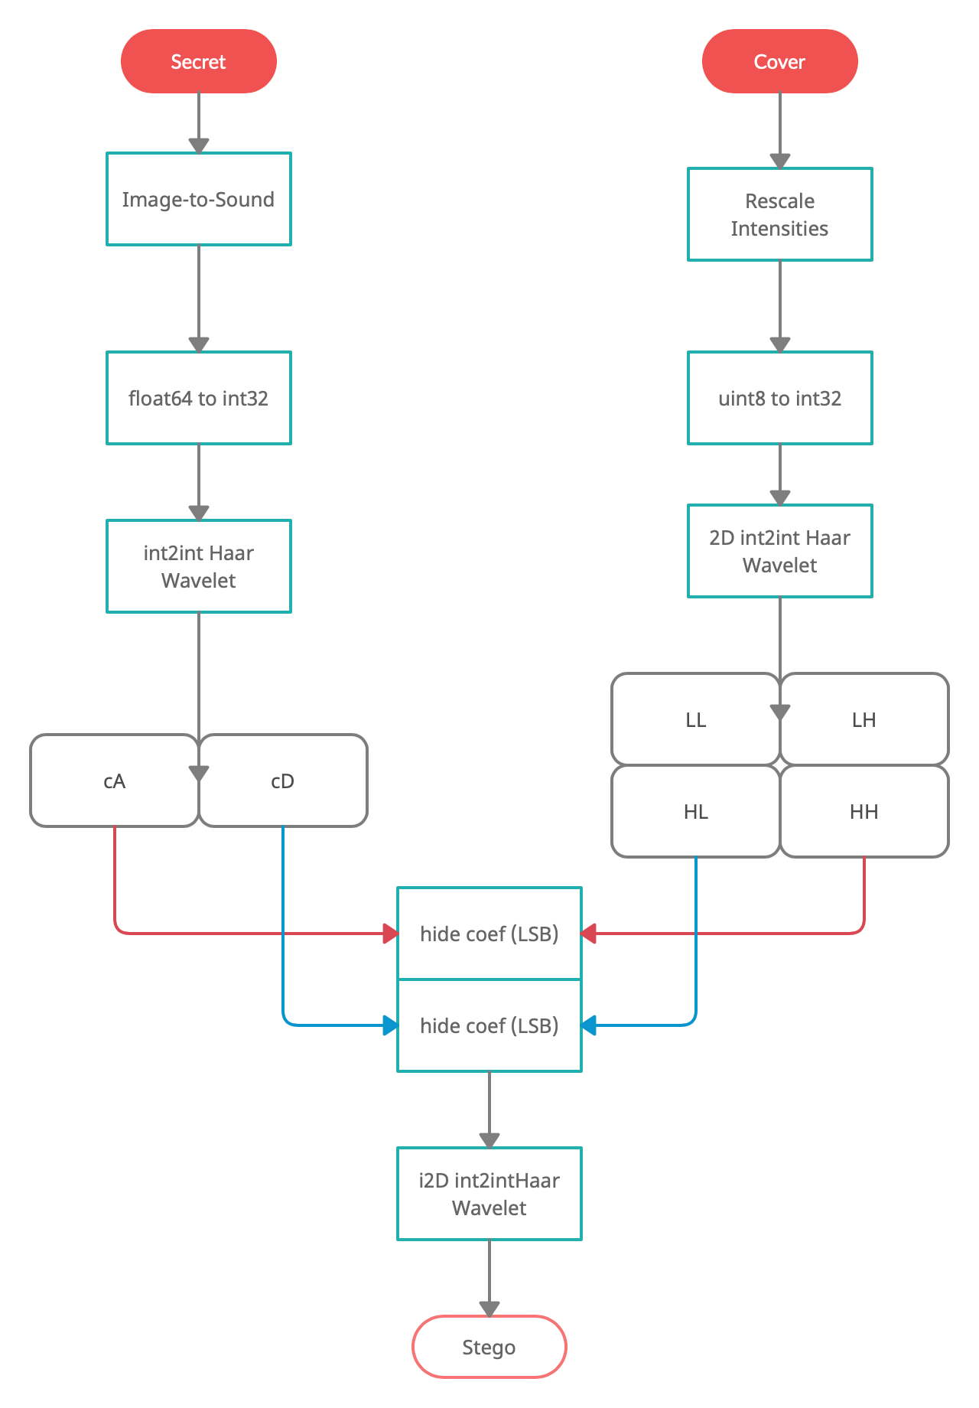

Slide 8

Results
The secret signal was hidden without any detection in the cover image.
But, when the secret signal was recovered, there was loss of information.
Small amount loss when using the local variable.
Significant when saving the cover image with the secret signal hidden.
The Secret Signal was unrecognizable.
Other issues were the signal size. Size of signal is $M=N∗L$.
After the wavelet transform, the total size of each array cA and cD resulted in $\left\lfloor \frac{M}{2}\right\rfloor$.
So, for an image of size $512×512$, then the total signal size is $M=\left(2∗512\right)∗512=524,288$ and the size of both cA and cD is $262,144$.
The larger the image, the longer it took to run the algorithm.
Secret Image | Size Image | N | M | Size cA & cD
Lena | (256, 256) | 512 | 131,072 | 65,536
Camera Man | (512, 512) | 1024 | 524,288 | 262,144
Cover Image | Size Image | Sub band Size
Tina | (1060, 1025, 3) | (530, 512)
Pretty Kitty | (4032, 3024, 3) | (2016, 1512)

Slide 9
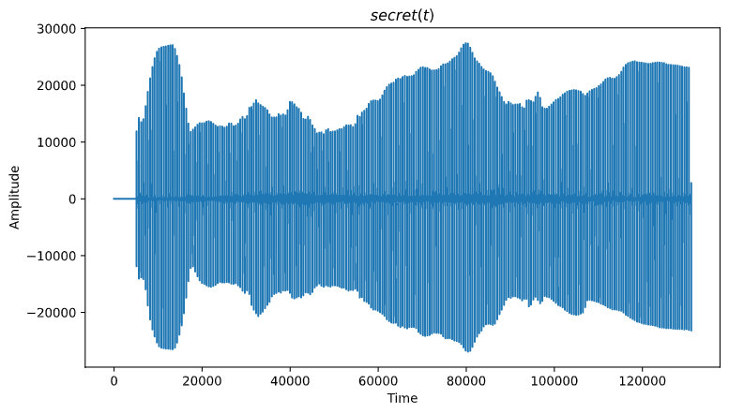

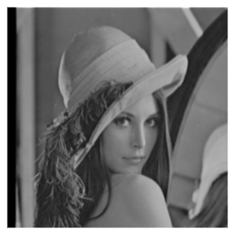

Slide 10
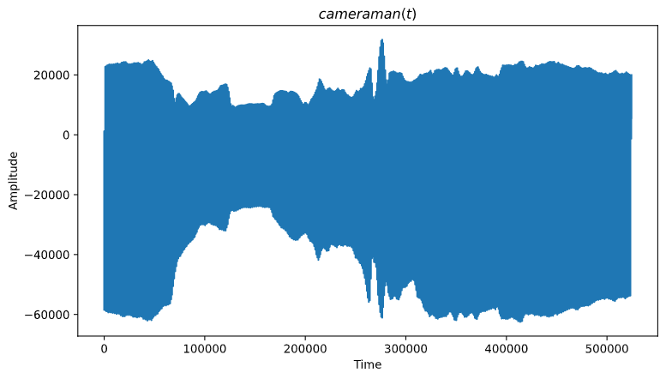
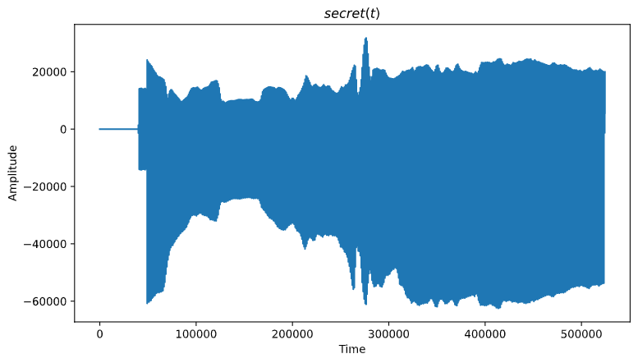
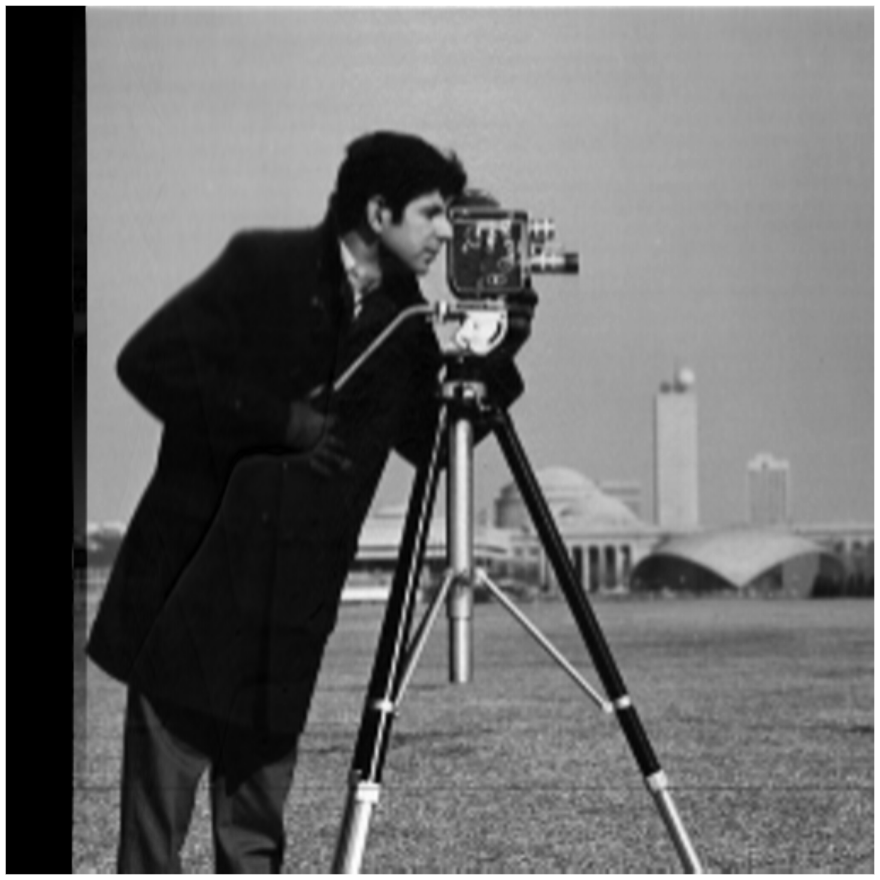

Slide 11
References
Shinde, Asawari S, and Archana B Patankar. “Image Steganography: Hiding Audio Signal in Image Using Discrete Wavelet Transform.” International Conference On Emanations in Modern Technology and Engineering (ICEMTE-2017) ISSN: 2321-8169, vol. 5, no. 3, Mar. 2017, pp. 331–334., doi:ijritcc.org.
Gulve, Avinash K, and Madhuri S Joshi. “An Image Steganography Method Hiding Secret Data into Coefficients of Integer Wavelet Transform Using Pixel Value Differencing Approach.” Mathematical problems in engineering 2015 (2015): 1–11. Web.
Shaik, Ahmad, and V Thanikaiselvan. “Comparative Analysis of Integer Wavelet Transforms in Reversible Data Hiding Using Threshold Based Histogram Modification.” Journal of King Saud University. Computer and information sciences (2018): n. pag. Web.
Xuan, Guorong et al. “Lossless Data Hiding Using Integer Wavelet Transform and Threshold Embedding Technique.” 2005 IEEE International Conference on Multimedia and Expo. IEEE, 2005. 1520–1523. Web.
Kawamura, Arata. “On Sound Signal Processing in Image to Sound Mapping Technique.” Applied acoustics 117 (2017): 1–11. Web.
Thuillard, Marc. Wavelets in Soft Computing. Singapore ;: World Scientific, 2001. Print.
Gonzalez, Rafael C, and Richard E. Woods. Digital Image Processing. , 2018. Print.
Takayuki Arai, Keiichi Yasu, Takahito Goto, Digital pattern playback: Converting spectrograms to sound for educational purposes, Acoustical Science and Technology, 2006, Volume 27, Issue 6, Pages 393-395, Released November 01, 2006, Online ISSN 1347-5177, Print ISSN 1346-3969, https://doi.org/10.1250/ast.27.393, https://www.jstage.jst.go.jp/article/ast/27/6/27_6_393/_article/-char/en

Slide 12

Thank you
Any questions?

